Slide 1
Truth Tables 101
How we keep track of the truthiness

Slide 2
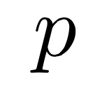
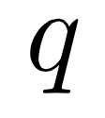
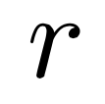
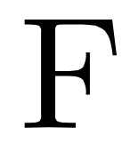
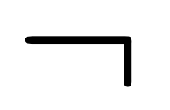
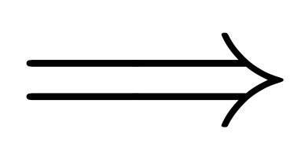
Recall...
We use letters
for statements=sentences that are True\False: \
=”and”
=”not”
=”or”
=”implies”

Slide 3
But First Group Work From Last Time!

Slide 5
When is…
Can be TRUE
Can be TRUE
Can be FALSE
Can be TRUE
Can be TRUE
Can be FALSE
Can be FALSE
Can be FALSE
TRUE?

Slide 6
So Much...

Slide 7
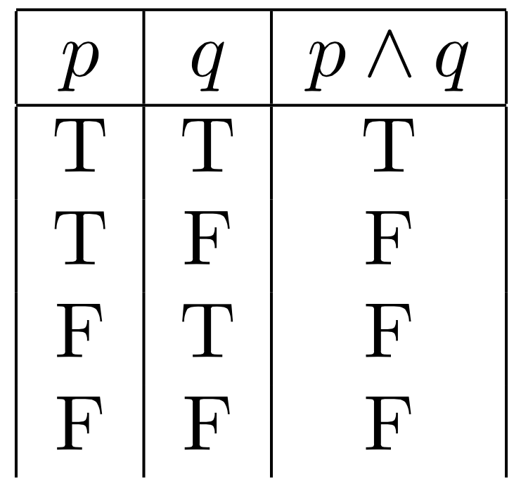
Keep a table:

Slide 8
Fill out table:
Only time it is true!

Slide 9
How about…

Slide 10
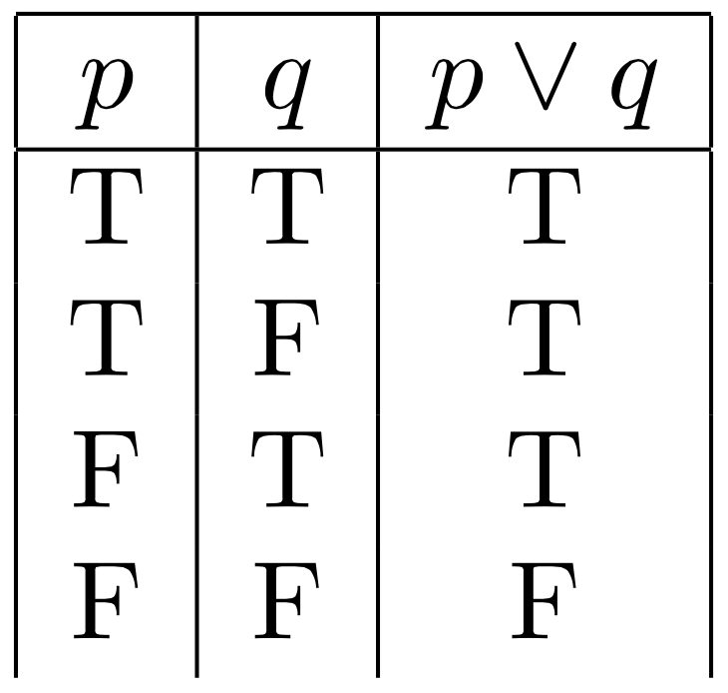
Keep a table:

Slide 11
Fill out table:
Only time it is false!

Slide 12
Don’t forget the English...
When is the following statements true/false:
It is raining outside and Rob has on a red hat
It is sunny or cold outside

Slide 13
It is raining outside and Rob has on a red hat
TRUE:
Rob has a red hat on is true
and
it is raining outside is true
False:
Rob has a red hat on is false
or
it is raining outside is false
translate

Slide 14
It is sunny or cold outside
TRUE:
It is sunny is true
or
It is cold is true
False:
It is sunny is false
and
it is cold is false
translate

Slide 15
So what’s that not all about?

Slide 16
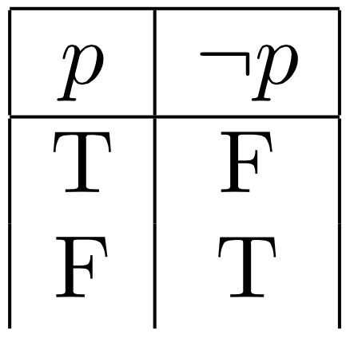
Keep a table:
Not flips the values!

Slide 17
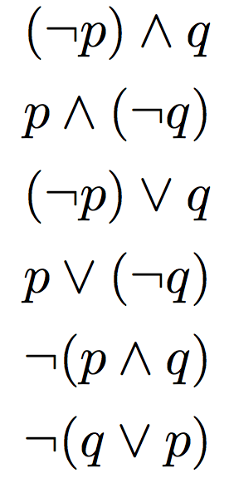
Group Work:

